Slide 1
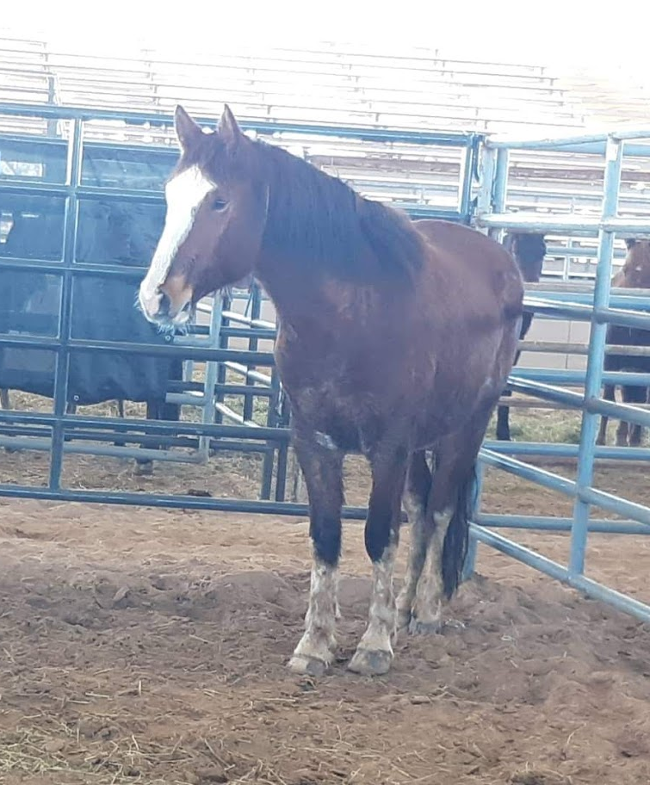
Mustang Population and Growth

Slide 2
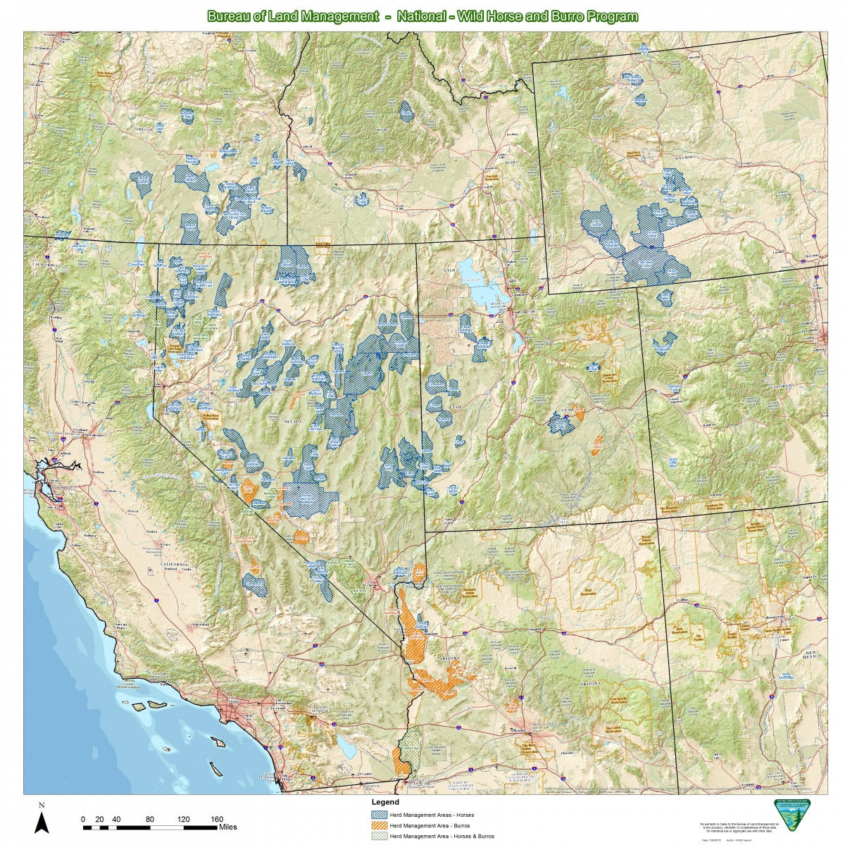
Where are mustangs Located?
Across 10 western states
Arizona
California
Colorado
Idaho
Montana-Dakotas
Nevada
New Mexico
Oregon-Washington
Utah
Wyoming

Slide 3
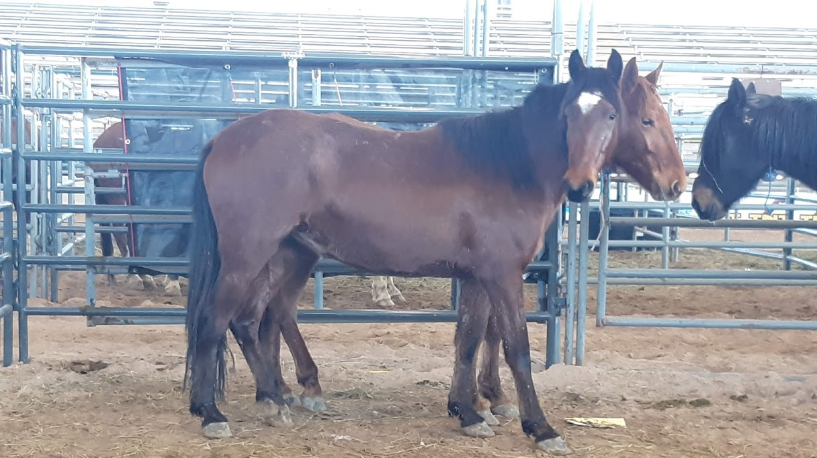
Facts about Mustangs
They’re typically around 13-15 hh
They can travel up to 20 miles a day seeking food
In the wild, they can have a lifespan of 15-20 years
They have no natural predators
They can double in population every 4-5 years

Slide 4
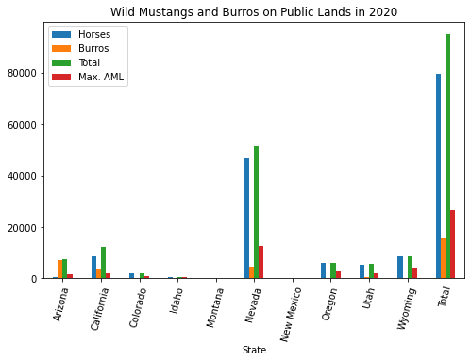
Mustang Populations are growing
Mustang mares have one foal with a gestation period of 11 months
a herd can consist of up to 25 individuals
Appropriate Management Level (AML), which is the number of wild horses and burros that can thrive in balance with other public land resources and uses

Slide 5
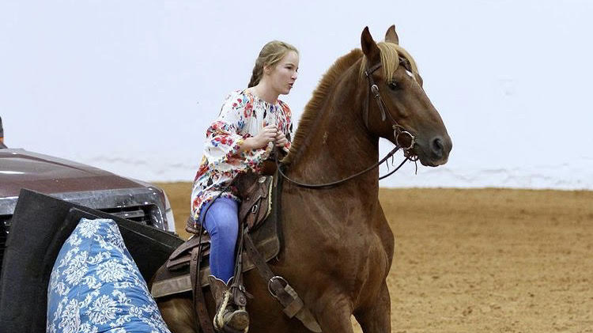
What can the BLM do?

Slide 6
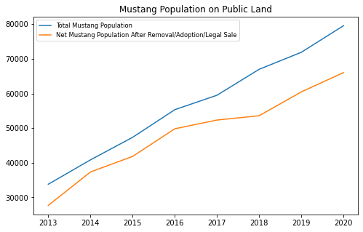
The BLM promotes the adoption of mustangs via horse events, such as the Extreme Mustang Makeover and the Mustang Magic Events, but as we can see, this isn’t enough
This has led the BLM to look into contraceptives in hopes of stalling or slowing the mustang’s population growth
Some of these consist of stallion vasectomies, and gelding procedures, mare IUDs, and mare contraceptives such as PZP, PZP-22 and GonaCon
Vasectomies and IUDs were found to be ineffective
More studies must be done to see the effect of gelding on herd dynamics

Slide 7
PZP and PZP-22
PZP is an immunocontraceptive made from pig ovaries. The foreign protein is attacked by the mare’s antibodies. Some of these antibodies attach to the mare’s sperm receptors and prevent fertilization. This effect can last for up to a year. Regular PZP is around 26 dollars per dose.
PZP-22 is similar. It is a combination of regular PZP and a form of pellet PZP that dissolves more slowly. The hope was that this PZP-22 would prevent fertilization for 22 months, however this was not the case. With a booster, the effect can last up to 3 years. PZP-22 is around 300 dollars per dose.
(they’re administered by dart gun!)

Slide 8
GonaCon
Gonadotropin-releasing hormone (GnRH) immunocontraceptive vaccine
GnRH is a protein released in the hypothalamus and is part of the pathway that leads to the production of testosterone, progesterone and estrogen.
Essentially hormone blockers.
Can be used as one shot, but more effective with two doses.
EPA registered, but not for commercial sale

Slide 9
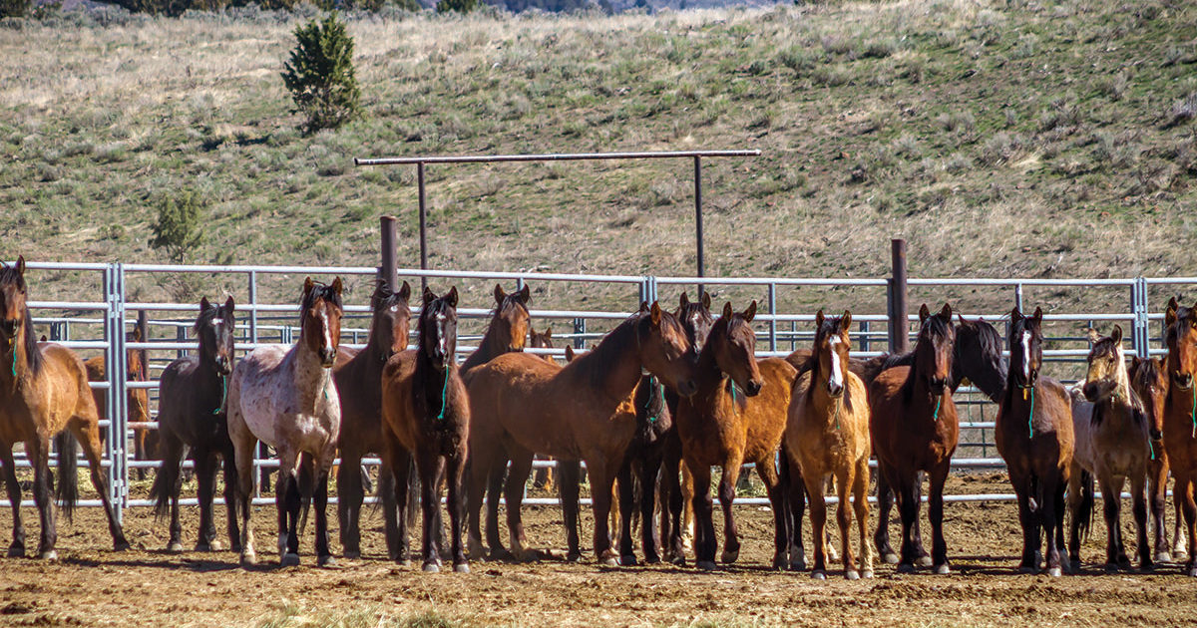
Holding Facilities

Slide 10
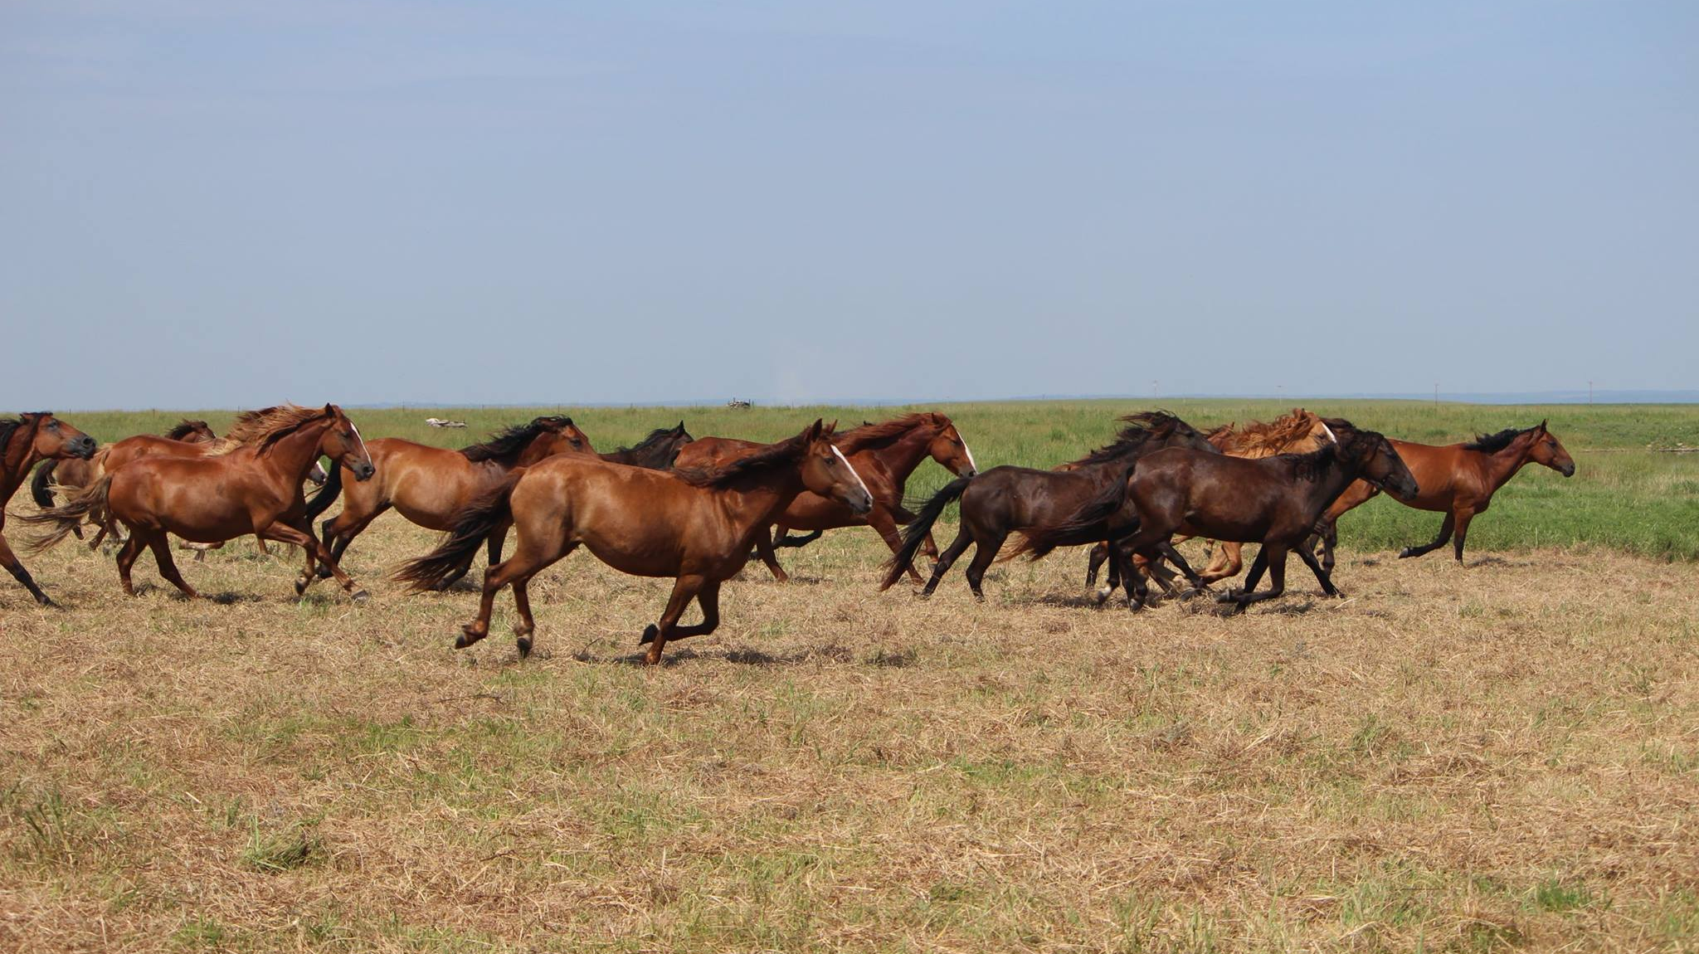
A Long-Term Holding Facility in Nowata Oklahoma

Slide 11
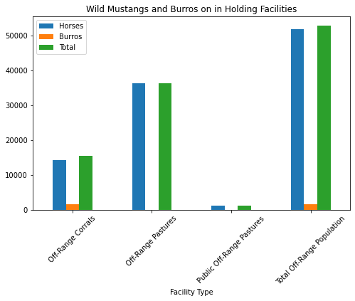
Long Term Holding is ideal, however Most places are near capacity
If a horse has gone through the adoption cycle 3 times or if it is over 10 years of age, it is put into long-term holding

Slide 12
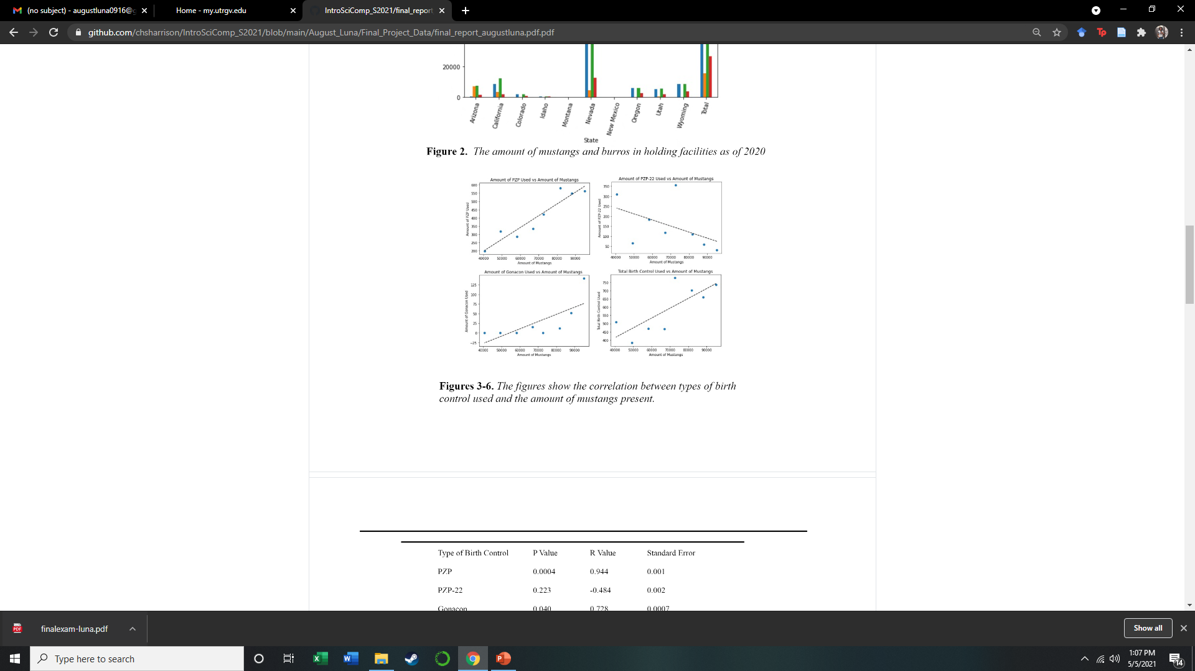
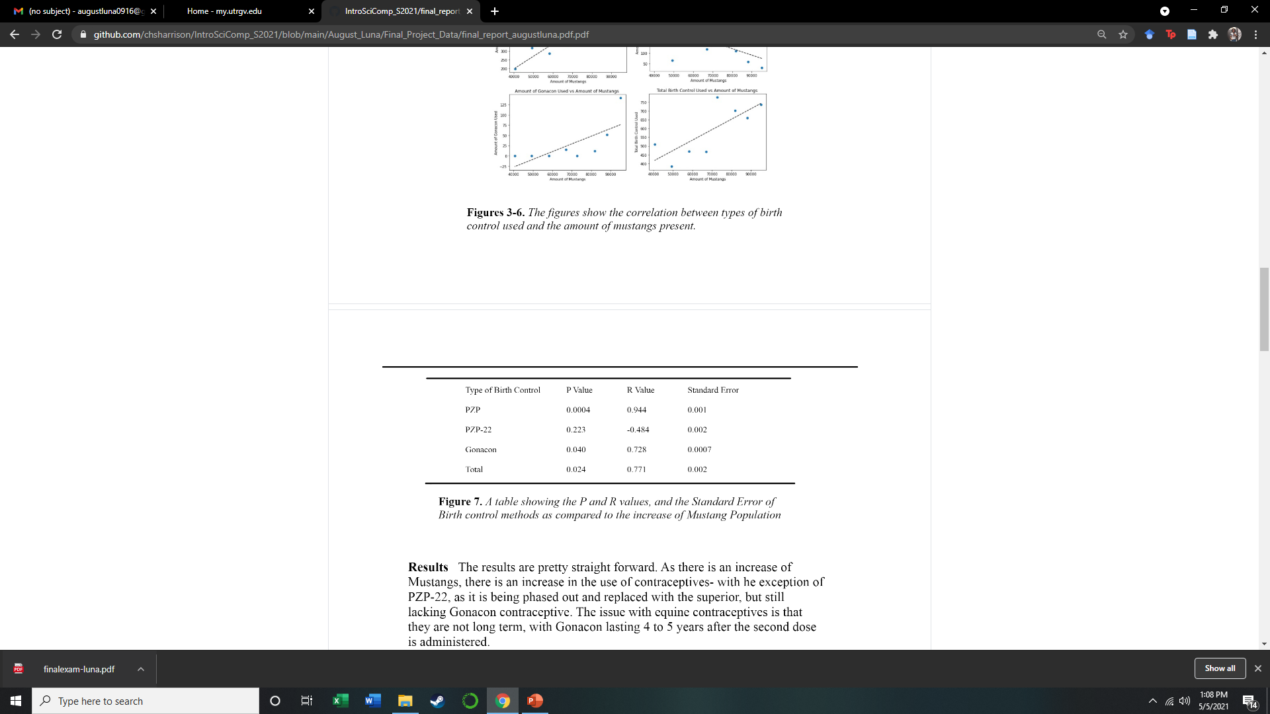

Slide 13
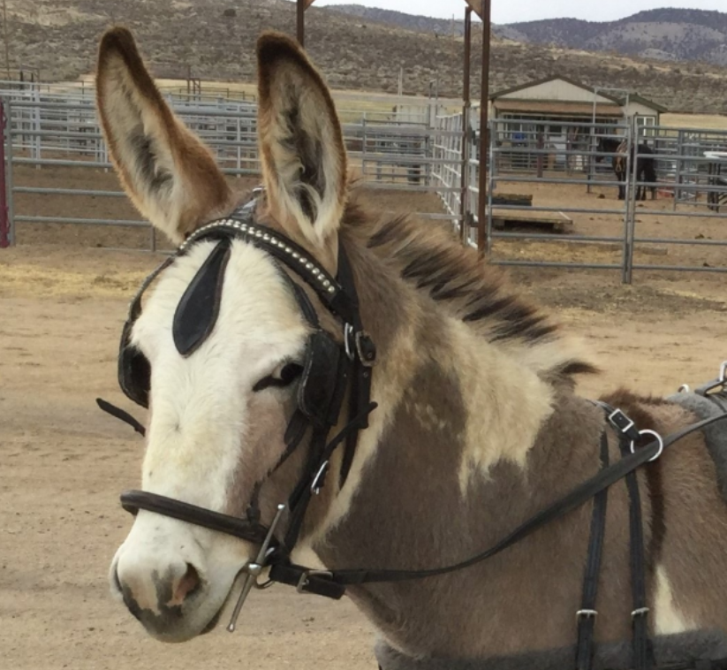
The end
*this is a picture of the BLM burro I almost purchased from the BLM’s Online Auction Event, but was outbid last minute (isn’t she cute?)

